Slide 1
US Census Visualization Process Book Milestone
CS171-Visualization
Simon Malian , Dingchao Zhang

Slide 2
Index
1. Overview and Motivation
2. Related Work
3. Questions
4. Data
5. Exploratory Data Analysis
6. Design and Implementation
7. Design and Implementation To Do

Slide 3
1. Overview and Motivation
Our project is to visualize a variety of United States demographic and socio-economic data including gender, race, age, income , venture capital, etc. gathered from US Census Bureau and other accredited agencies.
The benefits of understanding the current population characteristics will influence user’s understanding of each location.
The work can be used by others – e.g. public policy students – it will help facilitate developing realistic projections regarding further trends and challenges (e.g. aging population) that may be utilized, neutralized or reduced through proper planning

Slide 4
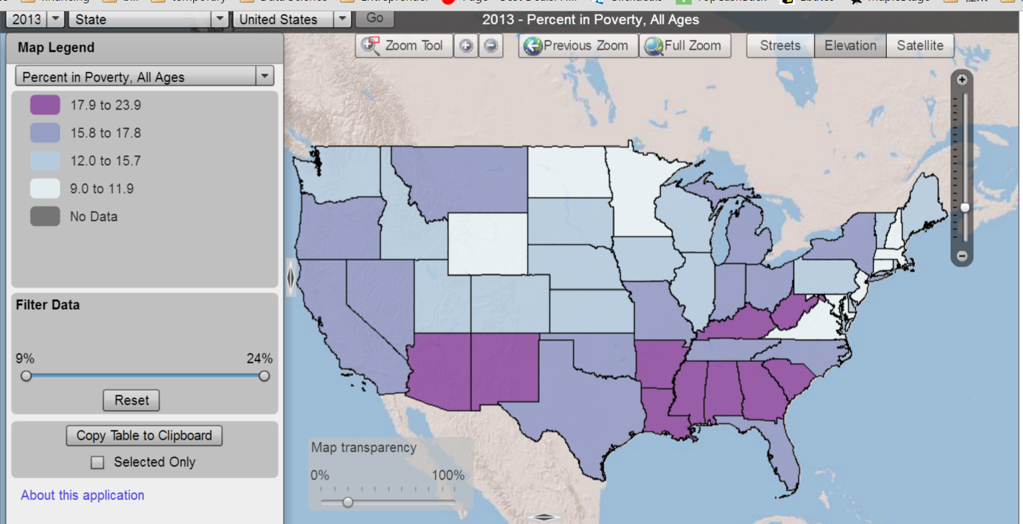
2. Related Work
We found and drew inspirations of Choropleth map from US Census Bureau provided data maps.
For example, we would follow a similar design of this poverty map:
What we can do better than US Census:
The US Census map seems all built upon flash player technology which is slow and takes long to load data, so we believe our D3 powered technology has advantage of responsiveness to it.
There is no coordinated view map of different aspects of data provided by US Census, and our project will fill that gap.

Slide 5
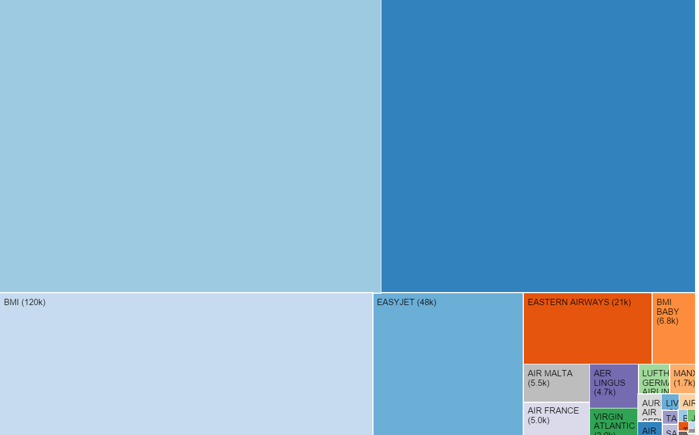
2. Related Work - conti
We found and drew inspirations of Tree map from various D3 blogs.
For example, we would follow a similar design of this UK flight data map:
The advantage of using Treemap:
A very good method to display hierarchical data.
The color and size dimensions are correlated with the tree strcture, one can easily see patterns that would be difficult to spot in other ways.

Slide 6
3. Questions
Questions we attempt to answer with this visualization are whether there are any correlations between location, socio-economic distribution, ethnic origin, household income, and other . For example one of the initial questions is what are some interesting stories that the visualization say about deviations in states’ ethnicity compositions and their venture capital activities
As the project goes, we would like also to consider new questions such as besides ethnicity distribution, would education level, age or gender other factors correlated with state’s economic performance.

Slide 7
4. Data
Source
We initialed pulled available CSVs with all 2010 Census data from US Census Bureau Web; the CSV is released separately for each state, and each CSV is hundreds megabytes, and therefore unsuitable for a d3 project and also un-pushable to Github. Thorough cleaning and de-sizing work would be required to process the data.
We found there are a few foundations, academic and business agencies summarized and published demographics and economy data on their websites, and The Henry J. Kaiser Family Foundation is one of them. We were able to download CSVs including population by age, gender, race/ ethnicity, income, for each state.
We were able to found Science and Engineering Indicators 2014 State Data Tool from National Science Foundation and downloaded economy data such as venture capital deals for each state.

Slide 8
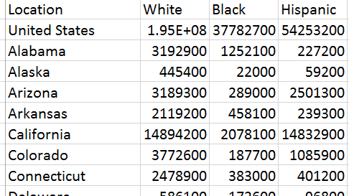
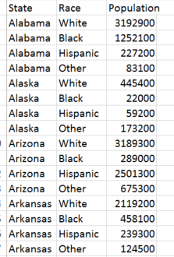
4. Data cont
Data wrangling
Besides cleaning unnecessary columns, meta data from downloaded CSV files, we need to change the structure completely for the data that will be used in Treemap visualization.
Because Treemap data requires to have a multiple layer hierarchical structure, which has “grandparents”, “parents”, “children”, etc. While the downloaded CSV files’ rows are aggregated mostly, so to transform to a Treemap data, we need to de-flat the data and create multiple layers using various Excel operations.
Original flat data
Transformed Hierarchical data
Change structure

Slide 9
5. Exploratory Data Analysis
We first used rudimentary, simple visualizations to take a better look at our data, this included looking at the overall data over different metrics such as gender, race, income; to understand its max, mean, min, median values.
For example, to look at the white group by state composition percentage data, we generates a bar chart in Excel

Slide 10
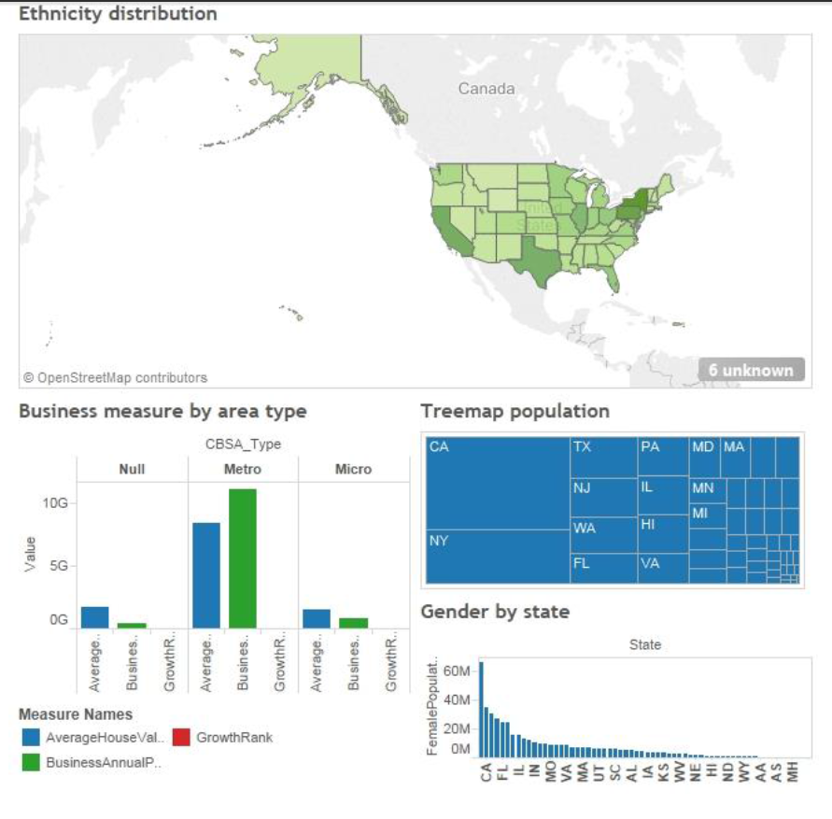
6. Design and Implementation
The main component of visualization will be in the form of a choropleth map , showing distributions of different data attributes, and we also consider introducing control elements to allow interactive exploration of the data (e.g. show the data for zipcode to analyze whether it is above/below certain threshold) as well as other linked coordinated views such as Treemap, Pyramid bar chart, area chart, etc.
6.1 Proposed Sketch

Slide 11
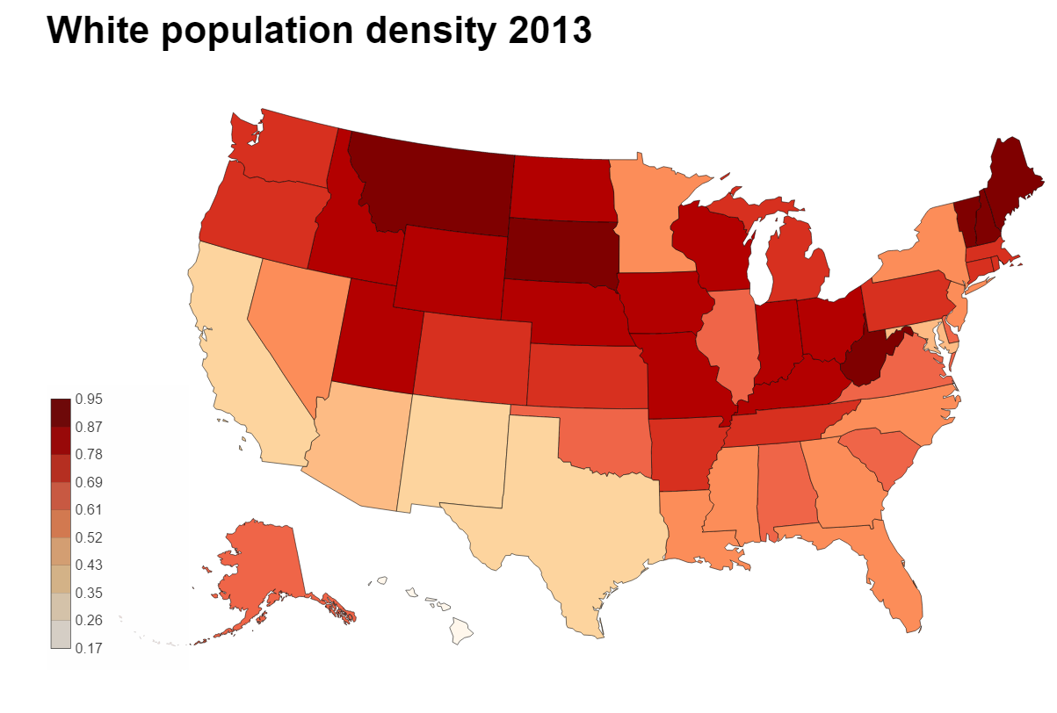
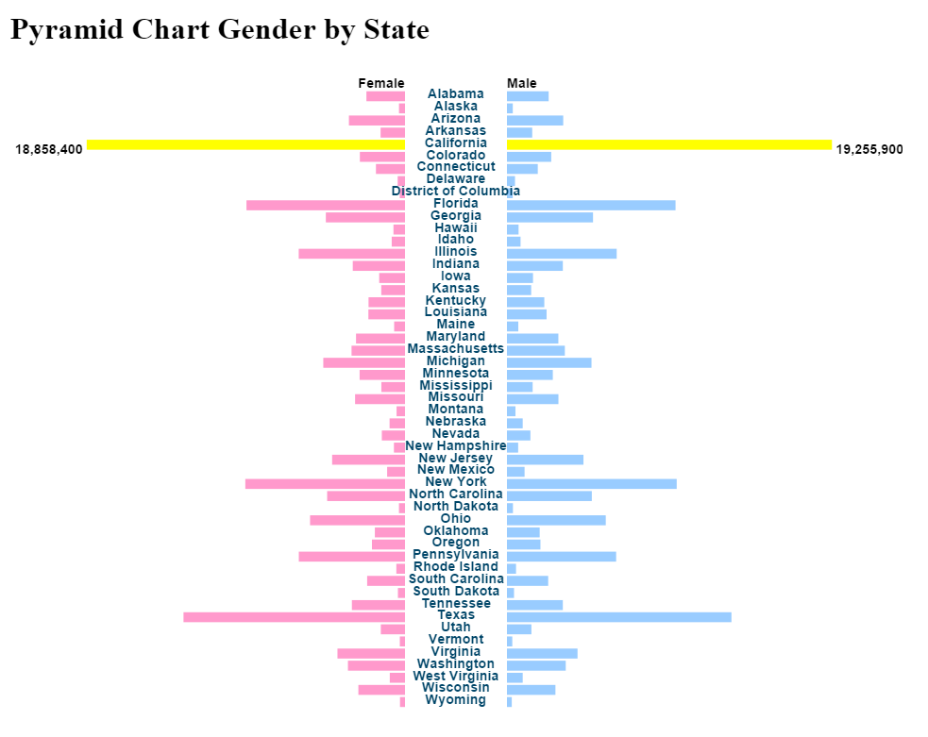
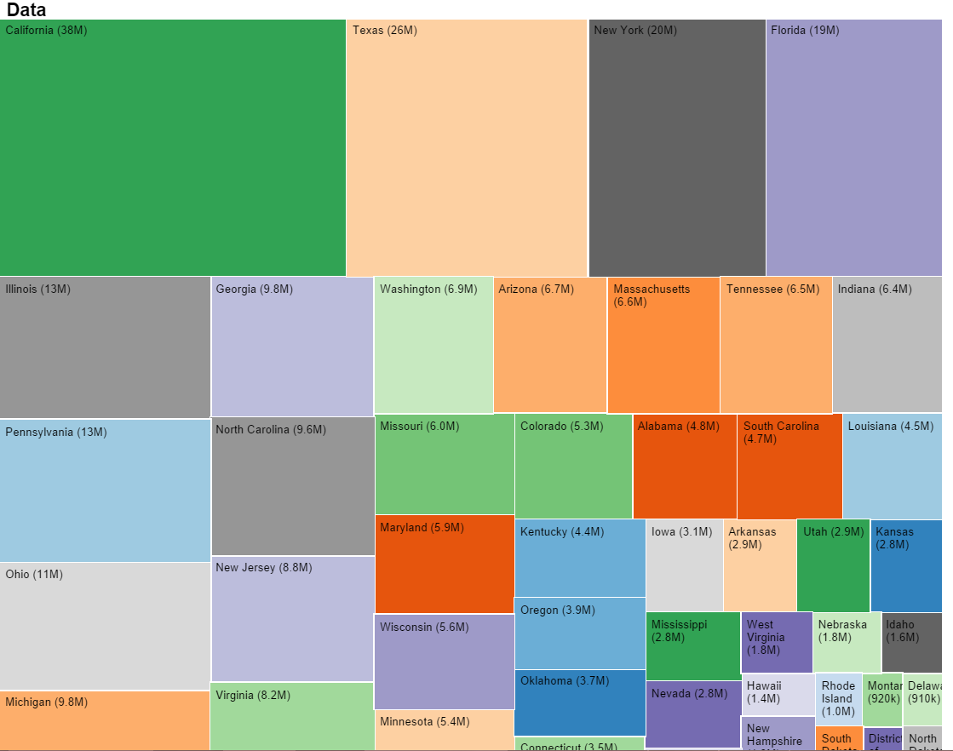
6. Design and Implementation cont
6.2 Milestone 1 Design Overview
Choropleth map, Multiple layer Tree
Map, Pyramid Bar charts are created

Slide 12
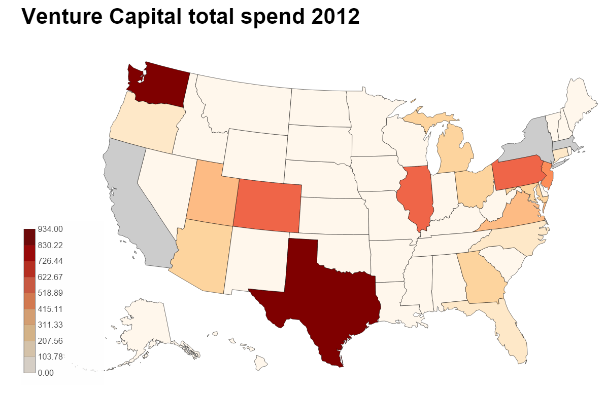
6. Design and Implementation cont
6.2.1 Milestone 1 Design Choropleth map overview
We created two Choropleth, the left one shows the white group population composition, range from 0 to 1, the higher, the more white in the state’s population, and the corresponding color ranges from gray to red, the more red, the more white in terms of composition in that state.
The right one shows the venture capital total spend per state , and the corresponding color ranges from gray to red, the more red, the more venture capital spending in that state, the CA and NY state’s data is missing in the map, and we plan to fix that in the next step.

Slide 13
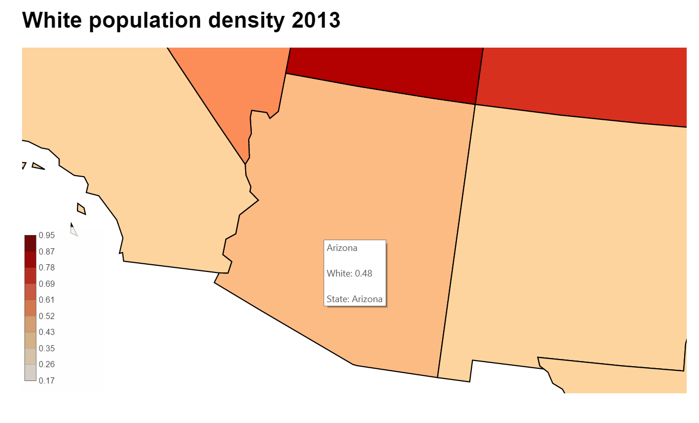
6. Design and Implementation cont
6.2.2 Milestone 1 Design Choropleth map overview cont
Zoomable and Hover over feature: If we click on the map, the view will be zoomed in and show the details of the map, also, the state’s details will be presented in a tooltip window as the following example shows Arizona’s data.

Slide 14
6. Design and Implementation cont
6.2.3 Milestone 1 Design Tree map overview
Treemap is a very good method to display hierarchical data. The color and size dimensions are correlated with the tree strcture, one can easily see patterns that would be difficult to spot in other ways.
Here we use 20 colors to differentiate each state, and the size corresponds to the population at parent level, and at child level, each ethnicity group’s population is presented in different sizes of square as well.

Slide 15
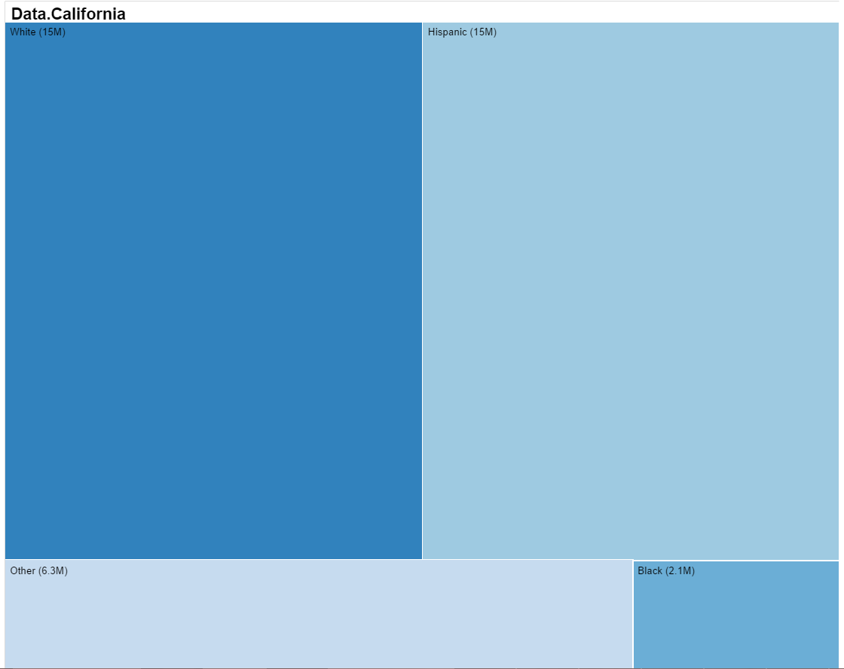
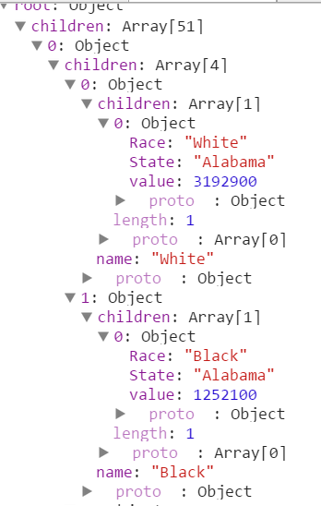
6. Design and Implementation cont
6.2.3 Milestone 1 Design Tree map overview cont
If we click any state, the Treemap will goes one layer down to show its race population in squares, in the following example we use clicked California’s square and it presents CA’s race group population.
The right side DOM shows the hierarchical structure of the data used in Treemap.

Slide 16
6. Design and Implementation cont
6.2.4 Milestone 1 Design Pyramid Bar Chart Overview
Pyramid bar chart is a very good method to show two contrasting group’s data in different unit, it allows user to compare at two levels: horizontal and vertical, therefore we use this model to compare Female vs Male population at 50 states.
We also introduced hover feature , when mouse over, the bar will be highlighted and show the exact population numbers at two gender groups.

Slide 17
7. Design and Implementation To Do – 04/10/2015
Create a coordinated view framework to link all different visualization in one graph using event handler, brushing and other d3 methods.
Create interactive tools such as filter, slider, selection box to allow users to view datasets of their interests
Add more datasets such as income, age, education, etc to enrich the visualization
Create ways to help user find particular patterns and correlations among different attributes of data.
Add interactive features to allow users to select
Add a year slider to venture capital to show yearly change
Add a area or line chart to show annual vc spend trend the whole country and then by state when selected by user
Add a linked vis between age and gender distribution, e.g. brush a certain agerange, will update the gender distribution of that age range
Other design and implementations as project evolves.

Slide 18
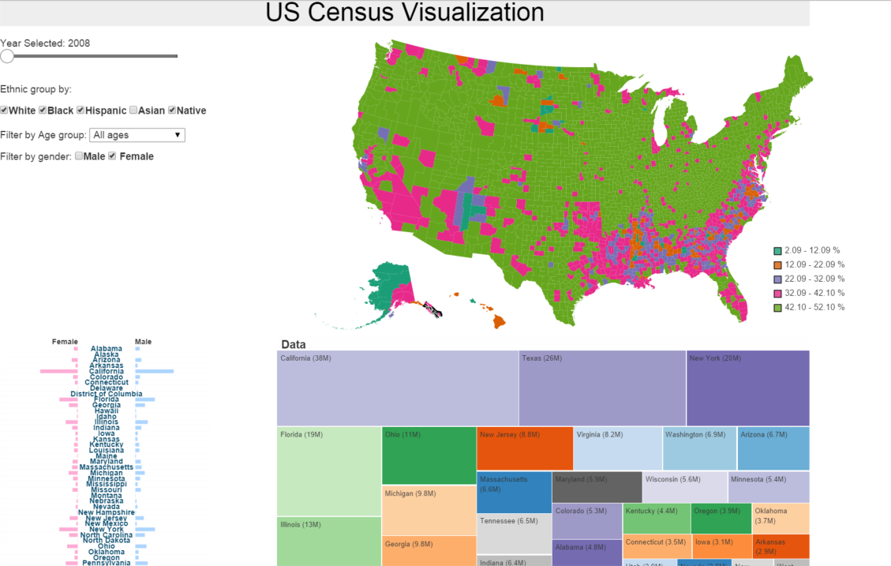
Latest Finished design – 04/26/2015

Slide 19
Design and Implementation To Do – 04/26/2015
To link choropleth, treemap, pyramid that these 3 vis will be updated synchronously.
Create an auto play function to show the changes throughout the years
If time allows, create a stacked bar by age group to show ethnic group distributions horizontally, and add a brush window function to it to allow it update other vis.
To add more CSS elements to make interactivity menu look more professional, reorganize visualizations layout and size to make the vis fit in one page without scrolling down.
Add loading and status bar, add observation
Once the above all done, finish process book and make a screen cast
TF ideas
-- Click treemap California, the California state will stand out in choropleth map
-- Have a minority group map, radio button , show the largest minority group, second largest minority group, etc…

Slide 20
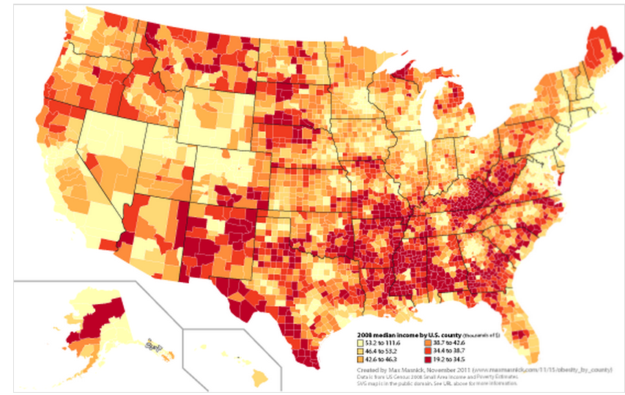
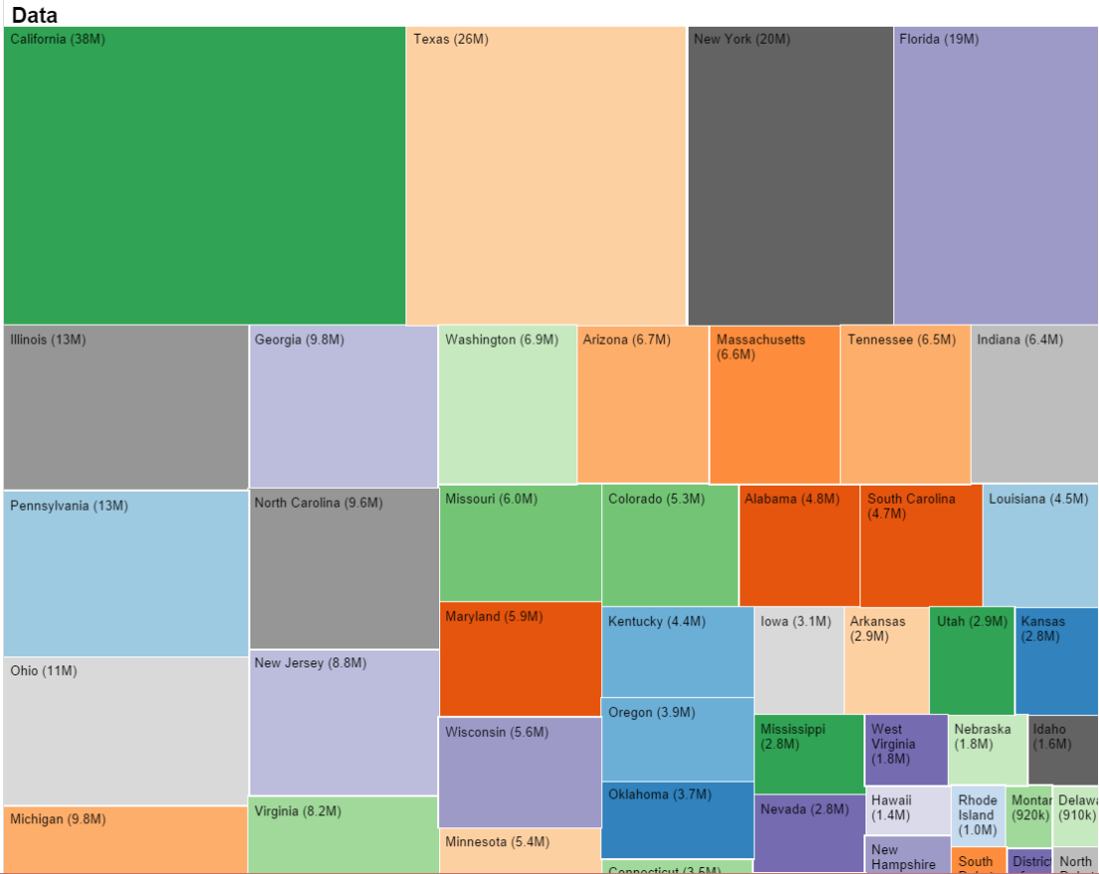
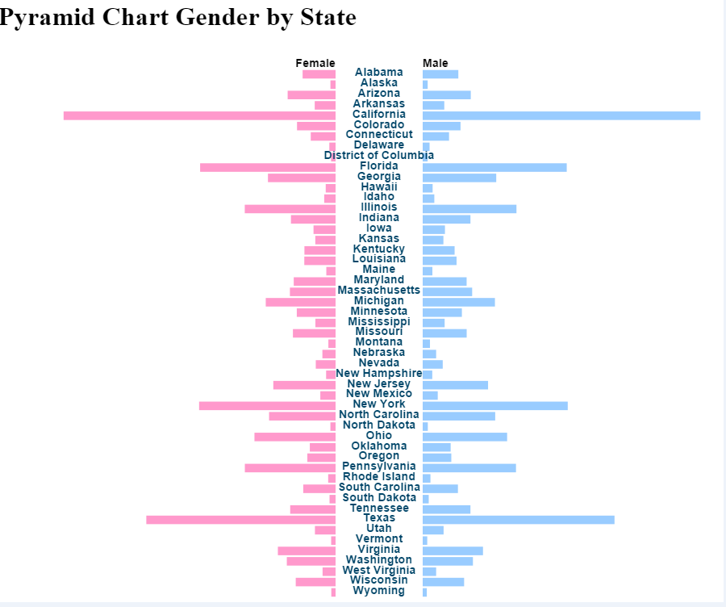
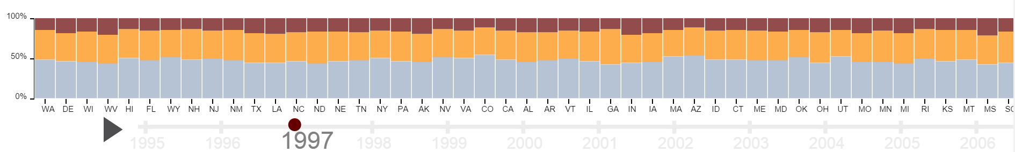
Planned final design– 04/26/2015
Total Pop& All Race
Race
Brush window in age group, will change other views;
Play button can animate changes in years, 6 years data
Gender by state
Age&Race
Year

Slide 21
Questions

Slide 22
8. Design Evolution Ideas 04/23/2015
Three directions of improvement
Depth : more resolution, showing the race(white) in county level
Variety: drop down menu that user can see race( black, Hispanic, other) in county level;
: year slide bar—animation
Brush function,
Treemap will get updated in different years as well : treemap takes care of total pop, race
Pop map takes care of race
Sex gender is shown already

Slide 23
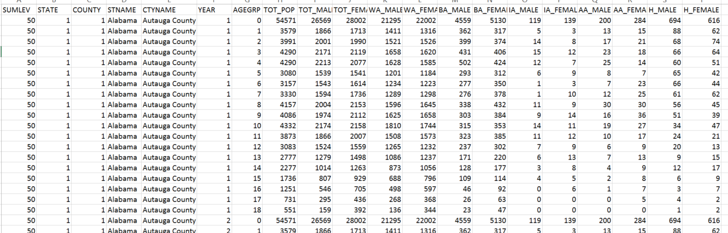
New data source– completed version County Characteristics Datasets: Annual County Resident Population Estimates by Age, Sex, Race, and Hispanic Origin: April 2010 to July 2013
http://www.census.gov/popest/data/counties/asrh/2013/CC-EST2013-ALLDATA.html
Optional data 2 http://www.census.gov/did/www/saipe/data/statecounty/data/2008.html
Data screen shot

Slide 24
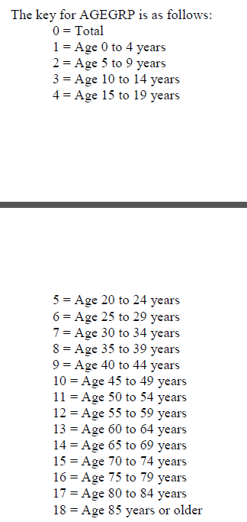
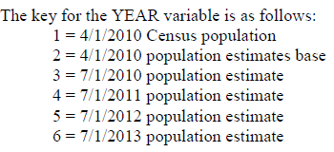
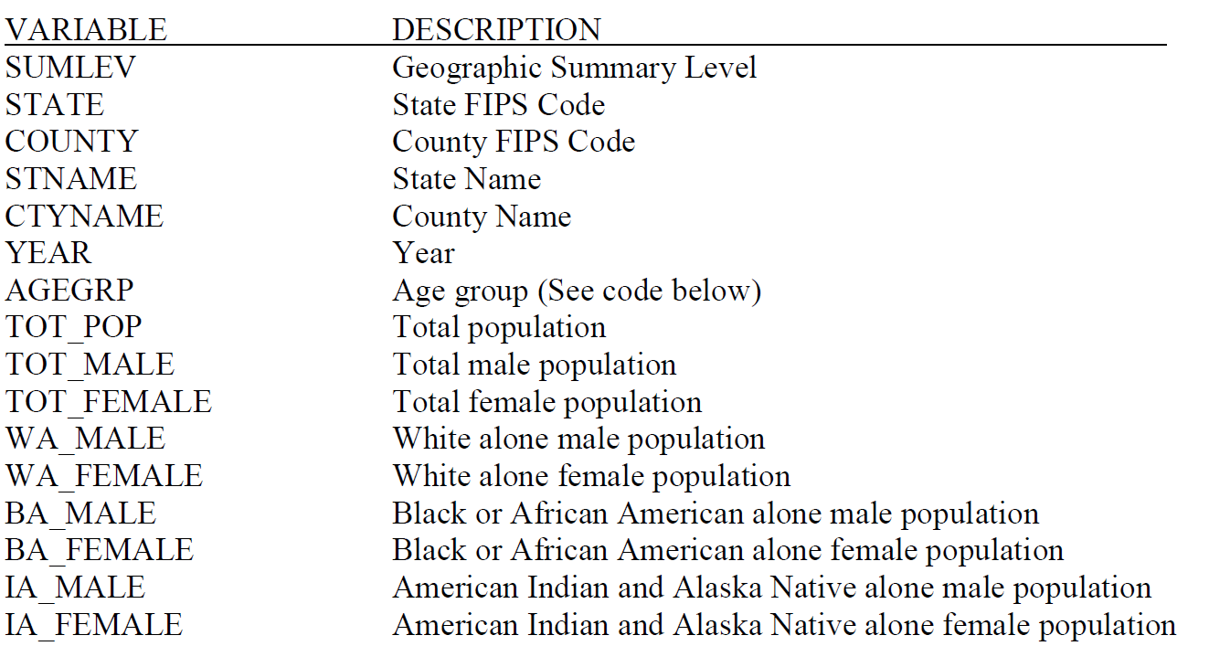
Meta data

Slide 25
Data process work for non-treemap work
Generate County FIPS code per state and county index
The FIPS county code is a five-digit Federal Information Processing Standard (FIPS) code (FIPS 6-4) which uniquely identifies counties and county equivalents in the United States, certain U.S. possessions, and certain freely associated states.
2. map, for each , filter in d3

Slide 26
Data process work for treemap
Deflat it to create hierarchal structure

